Slide 1


Studio project #1
Principles of design

Slide 2
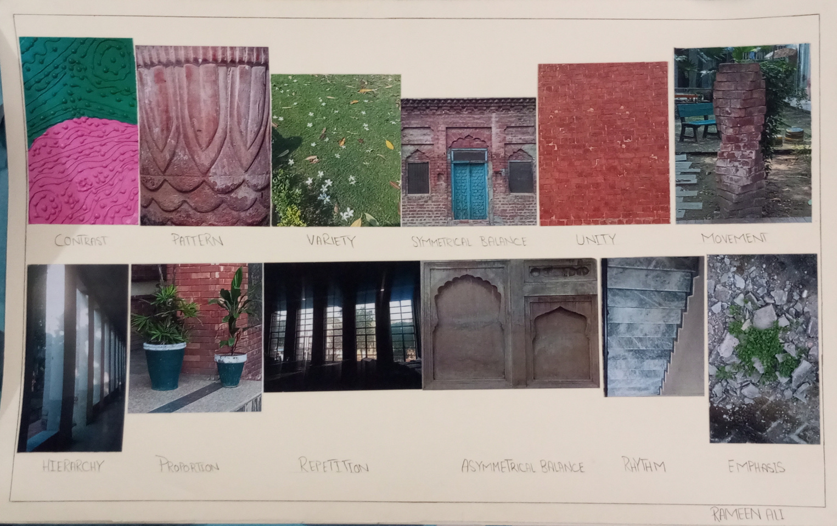
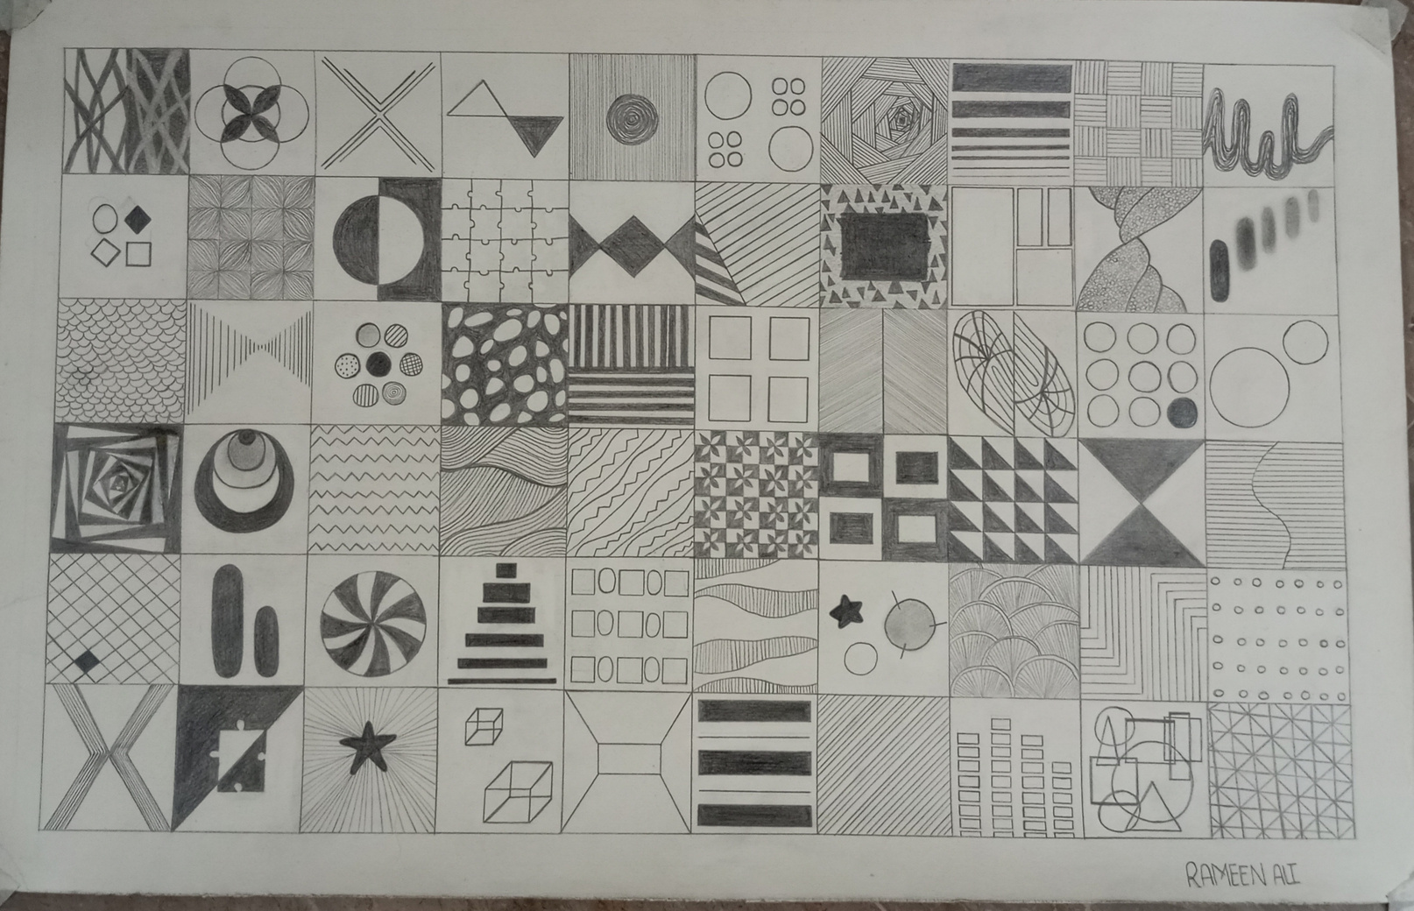
12 principles of design with examples from real world
And 60 patterns

